Slide 1

Chad Green
Serverless in Action
CodeStock
April 13, 2019

Slide 2


Who is Chad Green
Director of Software Development at ScholarRx
Community Involvement
Code PaLOUsa Conference Chair
Louisville .NET Meetup Organizer
Louisville Tech Leaders Meetup Co-Organizer
Louisville Tech Ladies Committee Member
Contact Information
→ chadgreen@chadgreen.com
 chadgreen.com
 ChadGreen
 ChadwickEGreen

Slide 3
Agenda
What is Serverless Computing
Functions as a Service
Serverless Options
Azure Functions Overview
Azure Functions in Action
Pricing
Best Practices

Slide 4
What is Serverless Computing
Serverless in Action

Slide 5

The evolution of application platforms
What is the right size of servers for the business needs?
How do I deploy new code to my servers?
What happens in case of server hardware failure?
How can I increase server utilization?
What media should I use to keep backups?
Which packages should be on my server?
Who monitors my App?
How often should I backup my server?
What size of servers should I buy?



Are my servers in a secure location?

How can I scale my app?

What happens if the power goes out?
Do I need a secondary network connection?
Who has physical access to my servers?
Which Operating System should I use?
How many servers do I need?
Who monitors my servers?
Do I need a UPS?
What storage do I need to use?
How often should I patch my servers?
It takes how long to provision a new server?
How can I dynamically configure my app?
On-Premises
Notes:
Get Hardware
Get and install Operating System
Get and install application framework
(No Click) Deploy code to the server
Host all of this somewhere in your datacenter
(No Click) Bunch of questions
Backup for your apps
Physical Security
Scaling Up
Monitoring (hardware and application)
And so on
Really important questions – but not key to core competency
Two clicks to get to next slide

Slide 6
The evolution of application platforms
What is the right size of servers for my business needs?
How can I increase server utilization?
How many servers do I need?
How can I scale my application?





How often should I patch my servers?
How do I deploy new code to my server?
How often should I backup my server?
Which Operating System should I use?
Which packages should be on my server?
Who monitors my application?
On-Premises
IaaS
Notes:
Infrastructure as a Service

Slide 7
The evolution of application platforms
What is the right size of servers for my business needs?
How can I increase server utilization?
How many servers do I need?
How can I scale my application?





On-Premises
IaaS
PaaS
Notes:
Platform as a Service
A lot of decisions are easily configurable
(Click) But still have to think about how to scale

Slide 8
The evolution of application platforms























The platform for next generation applications
On-Premises
IaaS
PaaS
Serverless
Notes:
Only Problem: How to build your app to best solve business problem?

Slide 9


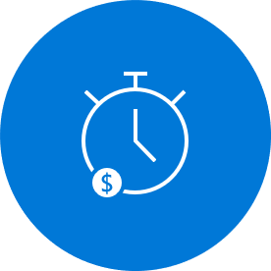
What is Serverless?
Abstraction of Servers
Event-Driven/Instant Scale
Micro-Billing
Notes:
Abstraction of Servers
Developers can just focus on their code – there are no distractions around server management, capacity planning, or availability
Event-Driven/Instant Scale
Application components react to events and triggers in near real-time with virtually unlimited scalability; compute resources are used as needed
Micro-Billing
Only pay for what you use: billing is typically calculated on the number of function calls, code execution time, and memory used

Slide 10


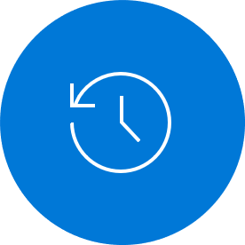
Benefits of Serverless
Manage apps not servers
Reduced DevOps
Faster Time to Market

Slide 11
Challenges of Serverless Architecture
Complexity
Organizational Support
No Runtime Optimization
Notes:
Complexity: Managing a monolithic application as a single unit is more straightforward than managing a fleet of purpose-built functions and the dependencies between them.
Organization Support: It’s a non-trivial consideration for some to move to a serverless paradigm
No Runtime Optimization: By its very nature, you mostly do not have control over the execution environment for the workload.

Slide 12
Function as a Service
Serverless in Action

Slide 13
Serverless is more than just one thing
Backend as a Service (BaaS)
Functions as a Services (FaaS)
Applications that significantly or fully depend on services (in the cloud) to manage server-side logic and state
Application run in stateless compute containers that are event-triggered, ephemeral, and fully managed by a 3rd party
Notes:
Like many trends in software there is no one clear view of what ‘Serverless’ is, and that is not helped by it really coming to mean two different but overlapping areas.
Backend as a Service – Serverless was first used to describe applications that significantly or fully depended on 3rd party applications or services (“in the cloud”) to manage server-side logic and state. These are typically “rich client” applications (think single page web apps or mobile apps) that use the vast ecosystem of cloud accessible databases, authentication services, etc.
Functions as a Service – Serverless can also mean applications where some amount of server-side logic is still written by the application developer but unlike traditional architectures is run in stateless compute containers that are event-triggered, ephemeral (may only last for one invocation), and fully managed by a third party.

Slide 14
Function Scale
Nano Services
Notes:
Monolith
Microservices
Functions → Nano Services

Slide 15
FaaS is at the center of serverless
Single responsibility
Functions are single-purposed, reusable pieces of code that process an input and return a result
Short lived
Functions don’t stick around when finished executing, freeing up resources for further executions
Stateless
Functions don’t hold any persistent state and don’t rely on the state of any other processes
Event driven & scalable
Functions respond to predefined events, and are instantly replicated as many times as needed
Functions-as-a-Service programming model use functions to achieve true serverless compute
Notes:
Easiest way to put this slide – Functions are single-purposed pieces of code which are short lived, stateless, driven by events, and automatically scale to handle need.

Slide 16
Serverless Options
Serverless in Action

Slide 17
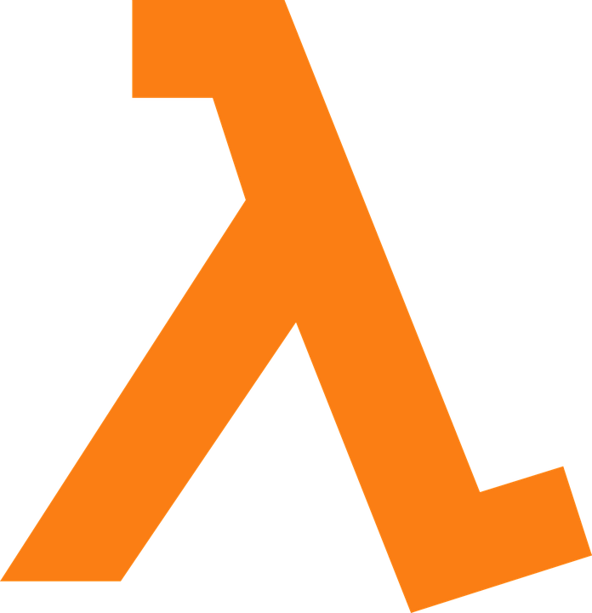
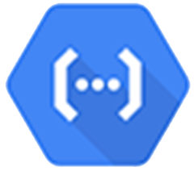



Market Landscape
AWS
Lambda
Google
Cloud Functions
IBM
Cloud Functions
Auth0 WebTask
Azure
Execute code on demand in a highly scalable serverless environment
Run code without thinking about servers. Pay only for the compute time you consume.
All you need is code
Event-driven serverless compute platform
Your vision. Your cloud.
Notes:
AWS Lambda
Google Cloud Functions
IBM Cloud Functions – Based on Apache OpenWhisk
Auth0
Azure

Slide 18


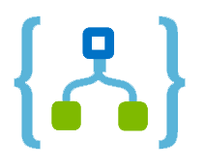



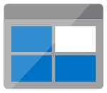





Azure Serverless Offerings
Event Grid
Manage all events that can trigger code or logic
Logic Apps
Design workflows and orchestrate processes
Functions
Execute your code based on events you specify
Database
Storage
Security
IoT
Analytics
Intelligence
Notes:
Event Grid is a fully managed event routing service that enables rich application scenarios by connecting serverless logic to event coming from multiple Azure services or from your own apps.
Logic Apps provides serverless workflows that allow developers to easily integrate data with their apps instead of writing complex glue code between disparate systems. Logic Apps also allow you to orchestrate and connect the serverless functions and APIs of your application.
Azure Functions is an event-driven compute experience that allows you to execute your code, written in the programming language of your choice, without worrying about servers. Benefit from scale on demand and never pay for idle capacity.
Backend as a Service
Azure Databases deliver a database ally for your serverless app. Azure SQL, MySQL, and Progress provide industry standard database capabilities. Cosmos DB is a multi-model database service that provides transparent scaling and replication of your data to wherever your users are.
Azure Storage provides durable, highly available, and massively scalable cloud storage to developers for cloud applications. Get options for unstructured object data, structured datasets, file storage, and queue storage for serverless communication between cloud apps.
Azure Active Directory provides cloud-based identity and access management. Using it, developers can securely control access to resources and manage and authenticate the users of their serverless apps.
IoT
Azure Stream Analytics is a fully managed analytics service for real-life streaming data. It allows you to author queries in simple, declarative, SQL-like language, and you only pay for the processing used per job. Event hubs is a fully managed service that simplifies mass ingestion of small data inputs, typically from devices and sensors, to process, route, and store the data.
Azure Bot Service allows you to build intelligent serverless bots that can interact with your users contextually through multiple channels like text/SMS, Skype, Microsoft Teams, Slack, Office 365, Twitter, and other popular services. Cognitive Services allows you to easily add intelligent features such as emotion and sentiment detection, vision, and speech recognition, language understanding, and knowledge and search – into your app. Using these services through serverless code or logic workflows minimizes the learning curve for creating intelligent apps.

Slide 19



Code
Events + data
Azure Functions
Serverless in Action

Slide 20
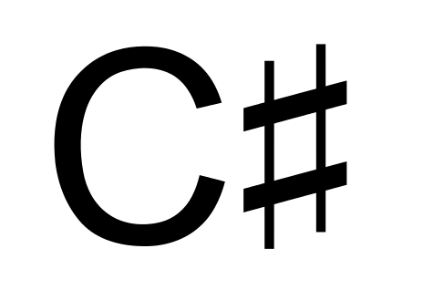






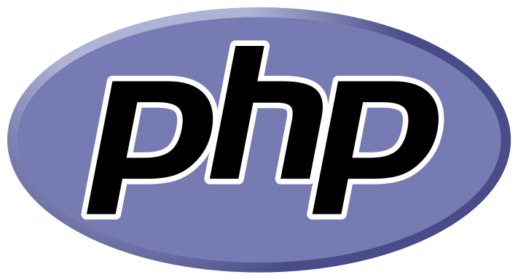

Features of Azure Functions
Choice of language
Batch
Notes:
Choice of language: Azure Functions is a polyglot solution which allows you to write functions in not just C#, F#, and JavaScript, but also Java, Python, PHP, TypeScript, Batch, Bash, and PowerShell
Choice of language: Azure Functions is a polyglot solution which allows you to write functions in not just C#, F#, and JavaScript, but also Java, Python, PHP, TypeScript, Batch, Bash, and PowerShell
Pay-per-use pricing model: Pay for only the time spent running your code. Azure Functions consumption plan is based on per-second resource consumption and executions.
Bring your own dependencies: Functions support both NuGet and NPM, so you can use your favorite libraries.
Integrated security: Protect HTTP-triggered functions with OAuth providers such as Azure Active Directory, Facebook, Google, Twitter, and Microsoft Account.
Simplified integration: Easily leverage Azure services and software-as-a-service (SaaS) offerings. These services can trigger your function and start execution or they can serve as input and output for your code. Such services include Cosmos DB, Event Hubs, Event Grid, Mobile Apps, Notification Hubs, Service Bus, Azure Storage, GitHub, and Twilio SMS messages
Flexible development: Code your functions right in the portal or set up continuous integration and deploy your code through GitHub, Visual Studio Team Services, and other support development tools including OneDrive, Bitbucket, Dropbox, and either a local or external Git repository
Open-source: The Functions runtime is open-source and available on GitHub

Slide 21
Features of Azure Functions
Choice of language
Pay-per-use pricing model
Batch
21
Notes:
Pay-per-use pricing model: Pay for only the time spent running your code. Azure Functions consumption plan is based on per-second resource consumption and executions.

Slide 22


Features of Azure Functions
Choice of language
Pay-per-use pricing model
Bring your own dependencies
Notes:
Bring your own dependencies: Functions support both NuGet and NPM, so you can use your favorite libraries.

Slide 23
Features of Azure Functions
Choice of language
Pay-per-use pricing model
Bring your own dependencies
Integrated security
Notes:
Integrated security: Protect HTTP-triggered functions with OAuth providers such as Azure Active Directory, Facebook, Google, Twitter, and Microsoft Account.

Slide 24






Features of Azure Functions
Choice of language
Pay-per-use pricing model
Bring your own dependencies
Integrated security
Simplified integration
Notes:
Simplified integration: Easily leverage Azure services and software-as-a-service (SaaS) offerings. These services can trigger your function and start execution or they can serve as input and output for your code. Such services include Cosmos DB, Event Hubs, Event Grid, Mobile Apps, Notification Hubs, Service Bus, Azure Storage, GitHub, and Twilio SMS messages

Slide 25






Features of Azure Functions
Choice of language
Pay-per-use pricing model
Bring your own dependencies
Integrated security
Simplified integration
Flexible development
Notes:
Flexible development: Code your functions right in the portal or set up continuous integration and deploy your code through GitHub, Visual Studio Team Services, and other support development tools including OneDrive, Bitbucket, Dropbox, and either a local or external Git repository

Slide 26
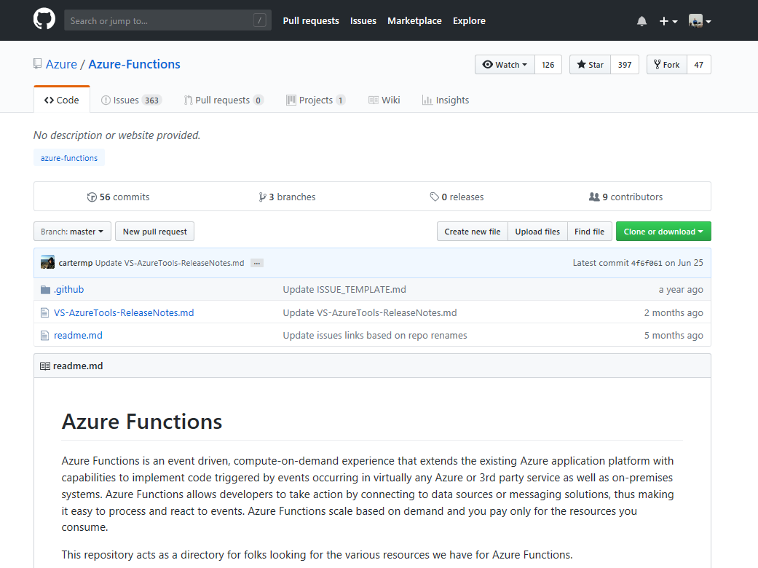
Features of Azure Functions
Choice of language
Pay-per-use pricing model
Bring your own dependencies
Integrated security
Simplified integration
Flexible development
Open-source
Notes:
Open-source: The Functions runtime is open-source and available on GitHub

Slide 27
Triggers and Bindings
Type
1.x
2.x
Trigger
Input
Output
Blob Storage





Cosmos DB





Event Grid



Event Hubs




External File



External Table




HTTP




Microsoft Graph
Excel tables



Microsoft Graph
OneDrive Files



Microsoft Graph
Outlook email


Microsoft Graph
Events




Microsoft Graph
Auth tokens


Mobile Apps




Notification Hubs



Queue Storage




SendGrid



Service Bus




Table Storage




Timer



Twilio



Webhooks



Notes:
Triggers and bindings are the things that facilitate easy communication with other services. This chart shows us the triggers and bindings currently supported. As we can see, there are a number of Azure services supported here…. for Storage, Database, Messaging, Notifications and so on. In addition to those, Functions also support generic Http triggers, which means you can easily write a piece of code that can be used to respond to REST requests or requests from any service that supports webhooks. This also provides a really fast and easy mechanism for building extensions to SaaS applications.

Slide 28



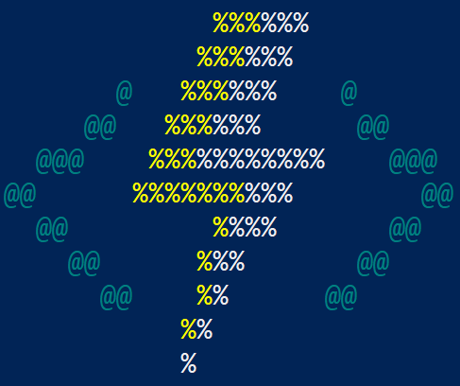
Develop How You Want
Azure Portal
Quickly get started without having to install anything else
Visual Studio 2017
First class C# development experience
Visual Studio Code
First class Node.js development experience
Edit any function project generated via CLI
Azure Functions Core Tools (CLI)
Build any kind of function and edit in IDE of your choice
Notes:
Four different tools you can use to work with Azure Functions
Azure Portal – Quickly get started without having to install anything else
Visual Studio 2017 – First class C# development experience
Visual Studio Code – First Class Node.js development experience plus you can edit any function project generated via the CLI
Azure Functions Core Tools (CLI) – Build any kind of function and edit in IDE of your choice

Slide 29
Runtime Versions
Runtime 1.x
Runtime 2.x
.NET Framework 4.6
.NET Core 2.0
Cross Platform
Language Extensions
Java
Binding Extensions
Microsoft Graph
Durable Functions
Notes:
There are two major versions of the Azure Functions runtime: 1.x and 2.x
Cross-platform development: Runtime 1.x support development and hosting only in the portal or on Windows. Runtime 2.x runs on .NET Core, which means it can run on all platforms supported by .NET Core, including macOS and Linux. This enables cross-platform development and hosting scenarios that are not possible with 1.x.
Languages: Runtime 2.x uses a new language extensibility model. Initially, JavaScript and Java are taking advantage of this new model. Azure Functions 1.x experimental languages have not been updated to use the new model, so they are not supported in 2.x. The experimental languages are Python, PHP, TypeScript, Batch, Bash, and PowerShell.
Runtime 2.x uses a new binding extensibility model that offers several advantages:
Support for third-party binding extensions
Decoupling of runtime and bindings. This allows binding extensions to be versioned and released independently. You can, for example, opt to upgrade to a version of an extension that relies on a new version of an underlying SDK.
A lighter execution environment, where only the bindings in use are known and loaded by the runtime
Microsoft Graph bindings – allow you work with data, insights and events from the Microsoft Graph. Use the Microsoft Graph API to connect to the data that drives productivity – mail, calendar, contacts, documents, directory, devices, and more.
Durable Functions is an extension of Azure Functions and Azure WebJobs that lets you write stateful functions in a serverless environment. The extension manages state, checkpoints, and restarts for you.
By default, function apps created in the Azure portal are set to version 2.x. When possible, you should use this runtime version, where new feature investments are being made. If you need to, you can still run a function app on the version 1.x runtime. You can only change the runtime version after you create your function app but before you add any functions.

Slide 30
Runtime Version Languages
Language
1.x
2.x
C#
GA (.NET Framework 4.7)
GA (.NET Core 2)
JavaScript
GA (Node 6)
GA (Node 8 & 10)
F#
GA(.NET Framework 4.7)
GA (.NET Core 2)
Java
N/A
Preview (Java 8)
Python
Experimental
Preview (Python 3.6)
TypeScript
Experimental
Supported through transpiling to JavaScript
PHP
Experimental
N/A
Batch (.cmd, .bat)
Experimental
N/A
Bash
Experimental
N/A
PowerShell
Experimental
N/A
Notes:
Next Slide – Ways to Run Azure Functions

Slide 31
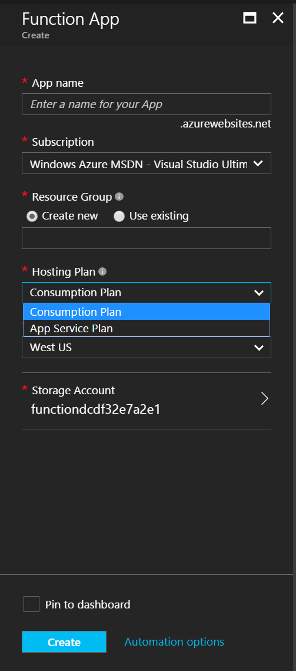
Consumption Plan
Pay for what you use without the need to reserve compute resources.
Function Apps are assigned to compute processing instances that are scaled dynamically by the platform.
Functions can have multiple parallel executions minimizing the total time needed to process requests.
Cost is driven by the number of executions and by accounting for memory size used and total execution time across all functions in a Function App as measured in gigabyte-seconds.
Selection guidance
Good option if your functions run at elastic scale with potentially intermittent executions.

Slide 32
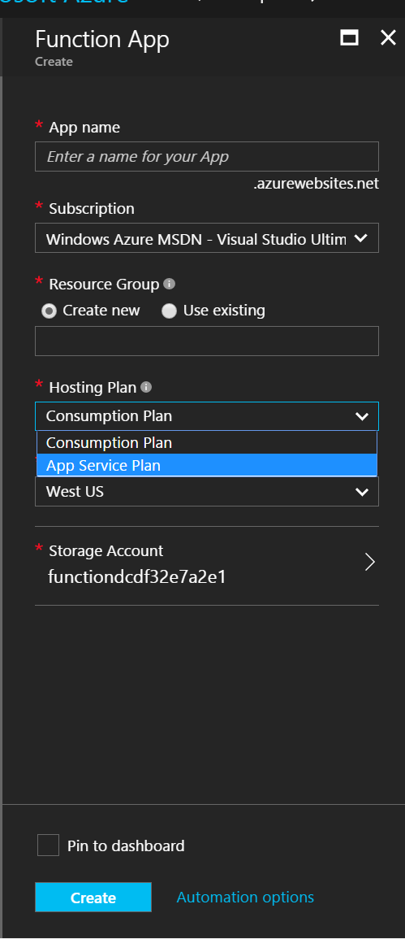
App Service Plan
Function Apps run on dedicated VMs, just like Web Apps work today
Dedicated VMs are allocated to your apps and they are always available whether code is being actively executed or not.
Selection guidance
Good option if you have existing, under-utilized VMs that are already running other code
Good option if you expect to run functions continuously or almost continuously

Slide 33
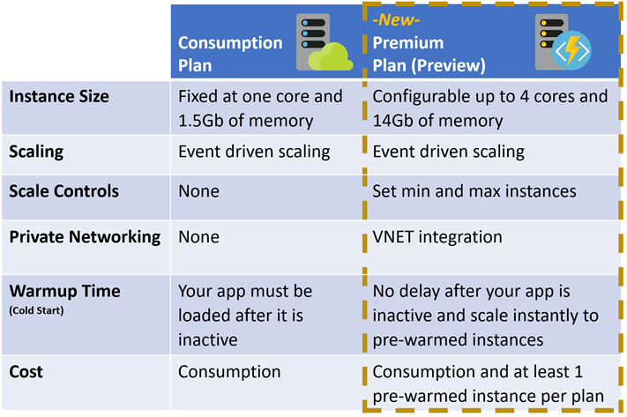
Premium Plan

Slide 34



Ways to Run Functions
Consumption
Serverless
App Service
Plan
Free, Basic,
Standard, Premium
App Service
Environment
Network Isolation
Azure Stack
On Premises
Azure Functions
Runtime
Functions on your Server
Azure IoT Edge
On Devices
Pay only for what you use! Metering is per execution and per Gb second.
All the advantages of Functions with the SLA and ‘always on’ feature of an App Service Plan
Your own dedicated cloud environment with network isolation for apps, higher scale, and the ability to connect securely to local vNets.
Leverage cloud innovations in on-premises infrastructure. Azure Stack brings the power of Azure to your data centers.
Run your Azure Functions on our local server (without the rest of Azure)
Run on IoT Devices by deploying custom modules.

Slide 35
Azure Functions in Action
Serverless in Action

Slide 36
Demo: Create an Azure Function from the Portal

Slide 37
Demo: Create an Azure Function from Visual Studio

Slide 38
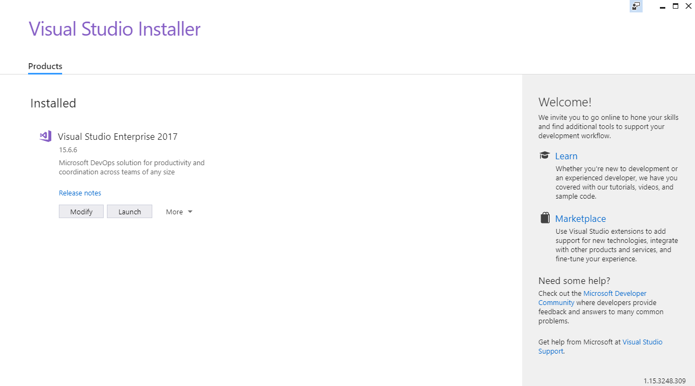
Notes:
Install Visual Studio 2017
Install Visual Studio 2017 version 15.5 or a later version.

Slide 39
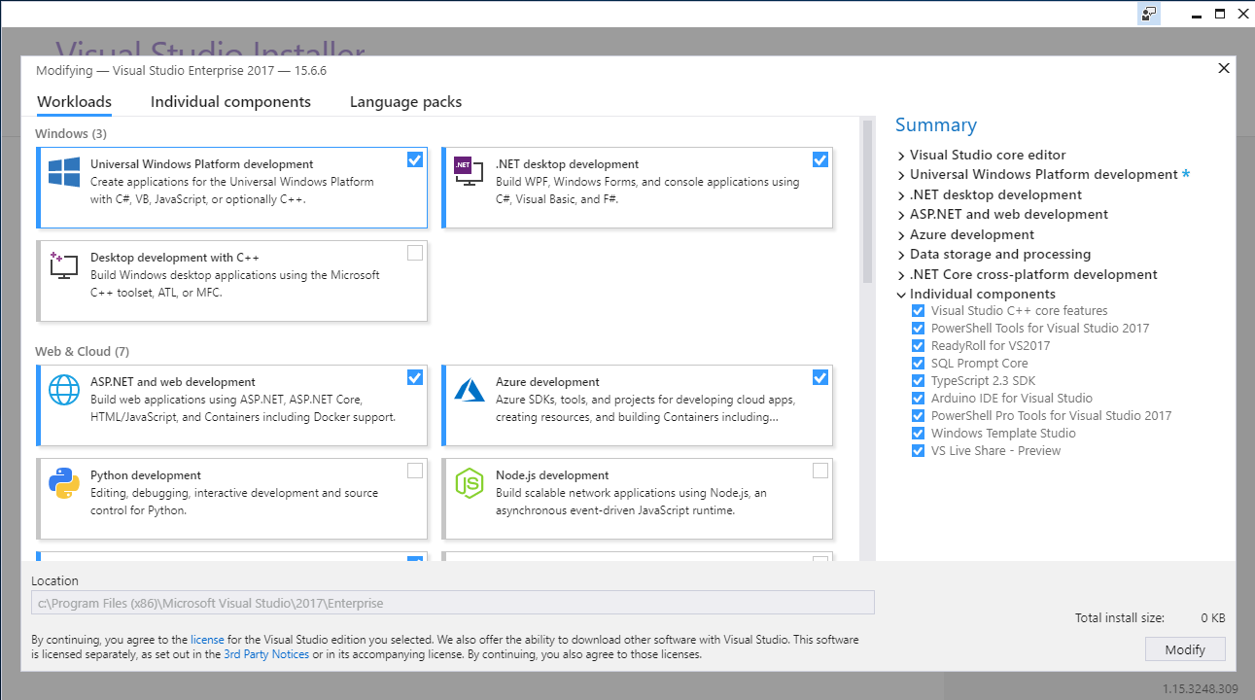
Notes:
Include the Azure development workload
Ensure that you include the Azure development workload

Slide 40
Proxies
Provide more control over all functions or just select methods
Can point to any HTTP resource
Take our current function url:
https://codemash.azurewebsites.net/api/HttpTriggerCSharp1?code=k9as3MKuDEAOyj3GbniZgJjWrn1cMqTAcDhbzqgAldUcYk67EX8QVg==&name={name}
Our function URL would then be like this:
https://codemash.azurewebsites.net/HelloWorld/{name}
Notes:
Azure Functions Proxies allows you to forward requests to other resource. You define an HTTP endpoint just like the HTTP trigger, but instead of writing code to execute when the endpoint is called, you provide a URL to a remote implementation. This allows you to compose multiple API sources into a single API surface which is easy for clients to consume. This is particularly useful if you wish to build your API as microservices (or nanoservices).
A proxy can point to any HTTP resource, such as:
Azure Functions
API apps in Azure App Service
Docker containers in App Service on Linux
Any other hosted API
Routing

Slide 41
Demo: Setting up routing and proxies

Slide 42
Deployment and Monitoring
Deployment Options
Monitoring Options
Visual Studio
Functions CLI
Azure DevOps
Azure Resource Manager
Maven / Jenkins
Azure App Insights
Function Logs
Azure Monitor (preview)
Notes:
Monitoring
Monitor – What is my app doing?
Alert – Is my app unhealthy?
Diagnose – Why is it unhealthy
Learn – What was my app doing?

Slide 43
Demo: Monitoring a Rapidly Scaling Function

Slide 44
Testing Your Functions
Recommended Way
Abstract logic away from the Function and test that abstraction
But I really need (want) to test the actual Function
Within test project, you will need to create a class that implements the ILogger which will be passed into the Functions

Slide 45
Demo: Testing Your Azure Functions

Slide 46
Pricing
Serverless in Action

Slide 47
Pricing – General Information
No upfront cost
No termination fees
Pay only for what you use

Slide 48
Consumption Plan Pricing
Meter | Price | Free Grant
Execution Time | $0.000016 per Gb-s | 400,000 GB-s
Executions | $0.20 per million executions | 1 million executions
Gigabyte-second (GB-s) – Combination of memory size and execution time
Executions – Each time a function is executed
Pricing Example
Execution Time
3 million executions x 1 second per execution = 3 million seconds
Resource consumption of 512-Mb → 1.5 million GB-s
1.5 million GB-s minus grant of 400,000 Gb-s = 1.1 million Gb-s
Execution Total = $17.60
Executions
3 million executions minus grant of 1 million executions = 2 million executions
2 million transactions at 20 cents per million = $0.40
Grand Total: $18.00
Notes:
Usage is aggregated at the function app level and counts only the time that function code is executed. Azure bills using two different units:
Resource consumption in gigabyte-seconds (GB-s). Computed as a combination of memory size and execution time for all functions within a function app. So if a function uses 512-Mb of memory and runs for 1 seconds, then each execution uses 0.5 GB-s.
Executions: Counted each time a function is executed in response to an event trigger.
Pricing Example: A function with observed memory consumption of 512-Mb executes 3,000,000 times during the month and has an execution duration of one second. Monthly billing would be calculated as follows: <CLICK>
Resource Consumption Billing Calculation
3 million executions x 1 second per execution equals 3 million seconds
If the resource consumption is 512-Mb over 3 million seconds; you get 1.5 million GB-s
There is a monthly free grant of 400,000 GB-s, so that reduces our scenario to 1.1 million GB-s to be charged for
Resource consumption is charged at $0.000016/GB-s; so that would come out to $17.60
Execution billing calculation
There were 3 million execution and Microsoft gives you 1 million free executions a month
So we are billed for 2 million executions at 20 cents per million executions; so that would be 40 cents
Total consumption billing calculation
So when you add the $17.60 from resource consumption cost and 40 cents for the execution cost; our total month bill is $18.00

Slide 49
Best Practices
Serverless in Action
Notes:
The following are best practices in how you build and architect your serverless solutions using Azure Functions.

Slide 50
Function Timeouts
Default timeout of 5 minutes
Maximum timeout of 10 minutes
For longer running functions use the App Service Plan and/or Durable Functions
Notes:
Consumption Plan restrictions
The timeout value can be changed by changing the function Timeout property in host.json
Durable Functions is an extension of Azure Functions and Azure WebJobs that lets you write stateful functions in a serverless environment. The extension manages state, checkpoints, and restarts for you.

Slide 51
The absolute minimum best practices
Functions should do one thing
Functions should be idempotent
Functions should finish as quickly as possible
Notes:
Idempotent – Clients can make the same call repeatedly while producing the same result. In other words, making multiple identical requests has the same effect as making a single request. Note that while idempotent operations produce the same result on the server (no side effects), the response itself may not be the same – a source’s state may change between requests.

Slide 52
General Best Practices
Avoid long running functions
Notes:
Large, long-running functions can cause unexpected timeout issues. A function can become large due to many Node.js dependencies. Importing dependencies can also cause increased load times that results in unexpected timeouts. Dependencies are loaded both explicitly and implicitly. A single module loaded by your code may load its own additional modules.
Whenever possible, refactor large functions into smaller function sets that work together and return responses fast. For example, a webhook or HTTP trigger might require an acknowledgment response within a certain time limit; it is common for webhooks to require an immediate response. You can pass the HTTP trigger payload into a queue to be processed by a queue trigger function. This approach allows you to defer the actual work and turn an immediate response.

Slide 53
General Best Practices
Avoid long running functions
Cross function communication
Notes:
Durable Functions and Azure Logic Apps are built to manage state transitions and communication between multiple functions.
If not using Durable Functions or Logic Apps to integrate with multiple functions, it is generally a best practice to use storage queues for cross function communication. The main reason is storage queues are cheaper and much easier to provision.
Individual messages in a storage queue are limited in size to 64-KB. If you need to pass larger message between functions, an Azure Service Bus queue could be used to support message sizes up to 256-Kb in the Standard tier, and up to 1-Mb in the Premier tier.
Service Bus topics are useful if you require message filtering before processing.
Event hubs are useful to support high volume communications.

Slide 54
General Best Practices
Avoid long running functions
Cross function communication
Write functions to be stateless
Notes:
Functions should be stateless and idempotent if possible. Associate any required state information with your data. For example, an order being processed would likely have an associated state member. A function could process an order based on that state while the function itself remains stateless.
Idempotent functions are especially recommended with timer triggers. For example, if you have something that absolutely must run once a day, write it so it can run any time during the day with the same results. The function can exit when there is no work for a particular day. Also if a previous run failed to complete, the next run should pick up where it left off.

Slide 55
General Best Practices
Avoid long running functions
Cross function communication
Write functions to be stateless
Write defensive functions
Notes:
Assume your function could encounter an exception at any time. Design your functions with the ability to continue from a previous fail point during the next execution. Consider a scenario that requires the following actions:
Query for 10,000 rows in a database.
Create a queue message for each of those rows to process further down the line.
Depending on how complex your system is, you may have: involved downstream services behaving badly, network outages, or quota limits reached, etc. All of these can affect your function at any time, You need to design your functions to be prepared for it.
How does your code react if a failure occurs after inserting 5,000 of those items into a queue for processing? Track items in a set that you have completed. Otherwise, you might insert them again next time. This can have a serious impact on your workflow.
If a queue item has already processed, allow your function to be a no-op.

Slide 56
Scalability Best Practices
Do not mix test and production code in the same function app
Notes:
There are a number of factors which impact how instances of your function app scale. The following are some best practices to ensure optimal scalability of a function app.
Functions within a function app share resource. For example, memory is shared. If you are using a function app in production, do not add test-related functions and resource to it. It can cause unexpected overhead during production code execution.
Be careful of what you load in your production function apps. Memory is averaged across each function in the app.
Do not use verbose logging in production code – it has a negative performance impact.

Slide 57
Scalability Best Practices
Do not mix test and production code in the same function app
Use async code but avoid blocking calls
Notes:
Asynchronous programming is a recommended best practice. However, always avoid referencing the Result property or calling the Wait method on a Task instance. This approach can lead to thread exhaustion.

Slide 58
Scalability Best Practices
Do not mix test and production code in the same function app
Use async code but avoid blocking calls
Receive messages in batch whenever possible
Notes:
Some triggers like Event Hub enable receiving a batch of messages on a single invocation. Batching messages has much better performance.

Slide 59
Scalability Best Practices
Do not mix test and production code in the same function app
Use async code but avoid blocking calls
Receive messages in batch whenever possible
Configure host behaviors to better handle concurrency
Notes:
The host.json file in the function app allows for configuration of host runtime and trigger behaviors. In addition to batching behaviors, you can manage concurrency for a number of triggers. Often adjusting the values in these options can help each instance scale appropriately for the demands of the invoked functions.
Settings in the hosts file apply across all functions within the app, within a single instance of the function. For example, if you had a function app with 2 HTTP functions and a concurrent request set to 25, a request to either HTTP trigger would count towards 25 concurrent requests. If that function app scaled to 10 instances, the 2 functions would effectively allow 250 concurrent requests (10 instances * 25 concurrent requests per instance).

Slide 60
How to get started
Start small, replace 1 API or background processing item
Integration is a great place, often it’s a new layer on top of old layers

Slide 61

Questions
→ chadgreen@chadgreen.com
 chadgreen.com
 ChadGreen
 ChadwickEGreen
Slides: bit.ly/CM19AzureFunctions

